Slide 1

IMAGE COMPRESSION
Data compression addresses the problem of reducing the amount of storage required to represent information
Image compression addresses the problem of reducing the amount of data required to represent digital images
1

Slide 2
Topics covered
Basic principles
Coding redundancy
Inter-pixel redundancy
Psycho-visual redundancy
Image compression model
Source encoder/ decoder
Channel encoder/ decoder
Quantization
Huffman coding
Arithmetic coding
Transform coding?
2

Slide 3
Data redundancy
Three basic data redundancies can be identified and exploited
Coding redundancy
Interpixel redundancy
Psycho-visual redundancy
Reduce or eliminate one or more of the above to achieve compression
*
3

Slide 4
Coding redundancy
Gray levels are coded by using more code words than what is absolutely necessary
Example:- fixed length codes
Employ a variable-length coding scheme
Assigns smaller code words for more frequent symbols. Ex:-Huffman codes
*
4

Slide 5
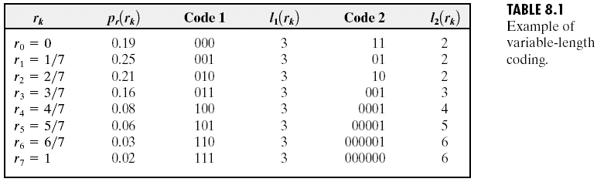
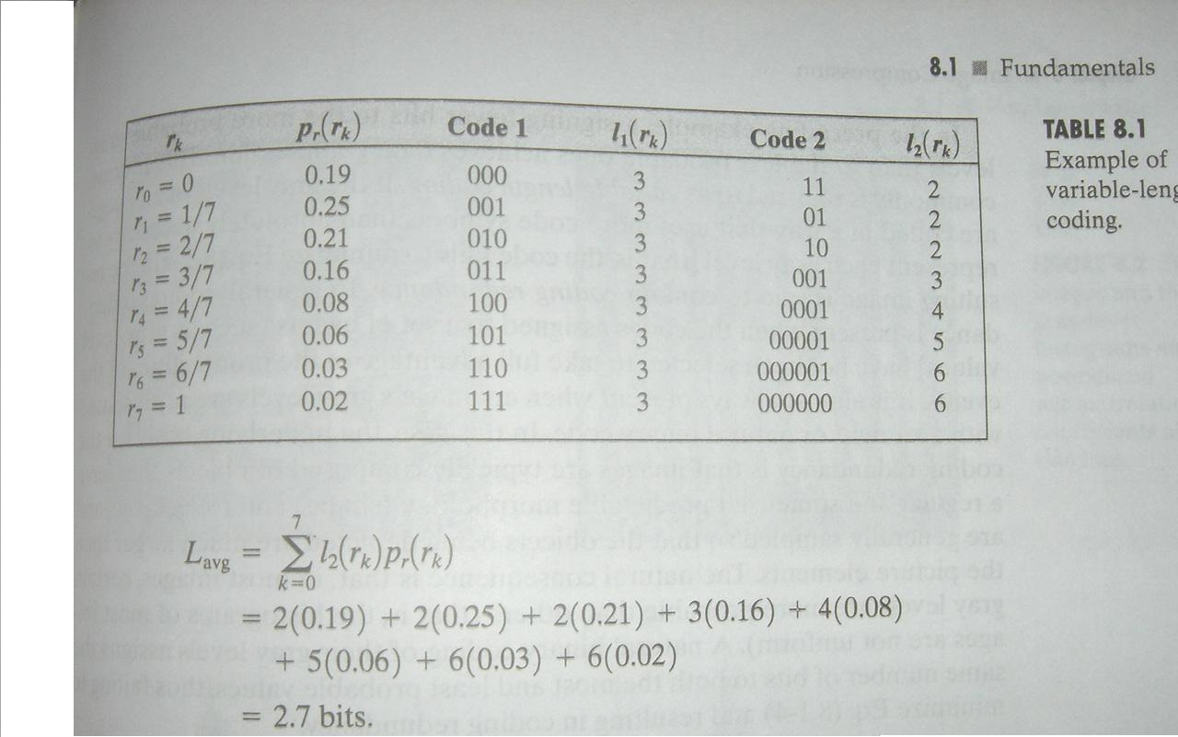
Variable length coding Example
*
5

Slide 6
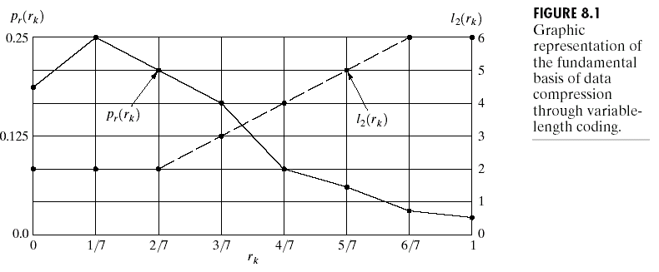
*
6

Slide 7
Inter-pixel redundancy
Pixels in an image are correlated
Spatial or geometric or inter-frame redundancy
Due to Structural or geometric relationships between the objects in the image.
Use a suitable transform to remove such redundancies
*
7

Slide 8
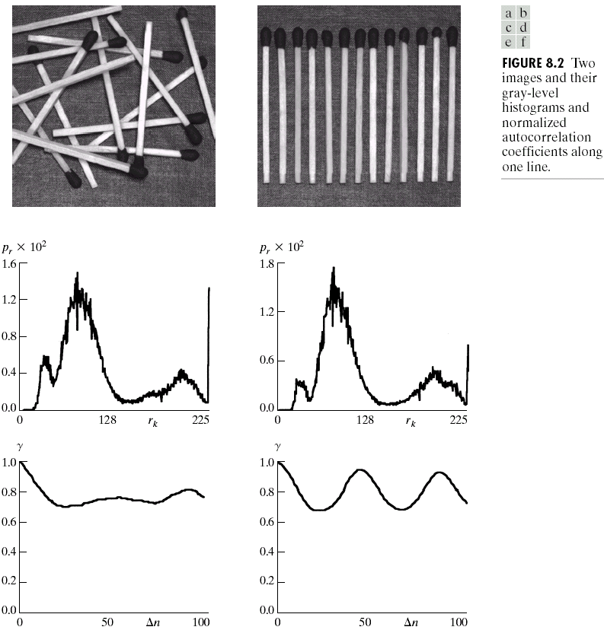
Two images and their gray-level histograms and normalized autocorrelation coefficients along one line
*
8

Slide 9
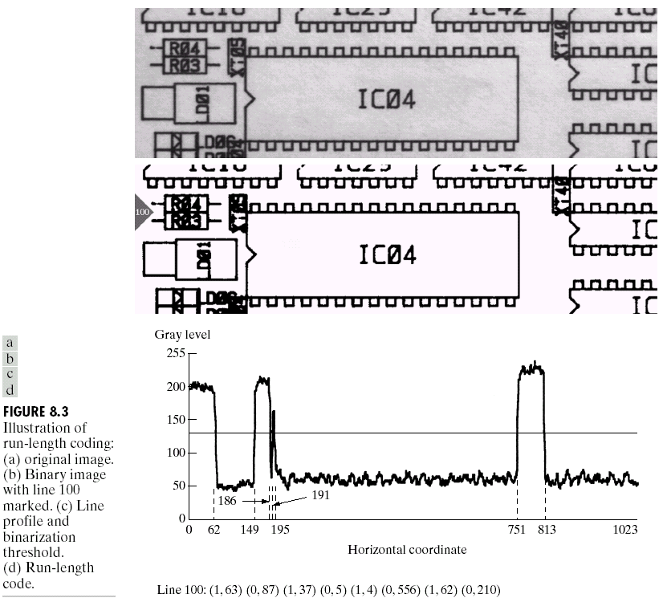
Run-length encoding
*
VKG NIT Calicut
9

Slide 10
Psycho-Visual redundancy
Eye does not respond with equal sensitivity to all visual information
Certain information has less relative importance than other information in normal visual processing
Such information (Ex:- high frequency content – eye is not sensitive to it) is said to be psychovisually redundant
Elimination of such info will not impair the quality of image perception.
*
10

Slide 11
Psycho-Visual redundancy…………Continue
Elimination of psychovisually redundant data results in a loss of quantitative information
Hence, it is called quantization- it is not reversible
The loss of info may be quantified by a Fidelity criterion
*
11

Slide 12
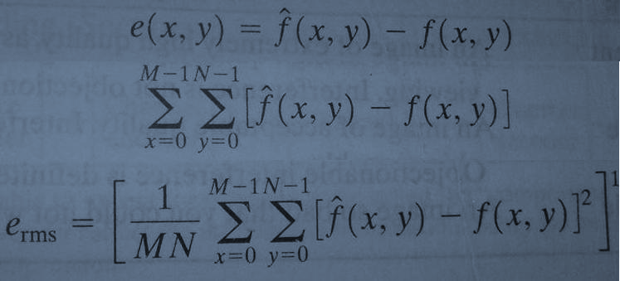
Fidelity criterion
*
12

